Slide 1
Introduction to CS
Qiang Lyu qiang@suda.edu.cn
Soochow University

Slide 2
1. Lets join QQ group 712763012 for all discussions of this course. 2. Register this on-campus website: http://10.10.48.15. You will submit all your homework to this site. Deadline: Saturday.

Slide 3
Interaction symbols
0: No
1: Yes
2: communication problems
5: Xu…………
6: praise, applaud
7: raise hand for speaking
……

Slide 4
Topics of this course
What is CS
Why is CS so hot
Where is CS being applied to
How to learn CS

Slide 5
What is CS?
CS: Computing Science
Science of using computers to solve target problems in real world
“computing refers to a goal-oriented activity requiring, benefiting from, or associated with the creation and use of computers.”—CC2020
So, what is computer?
Notes:
As originally expressed in CC2005 [Acm02], computing includes a variety of interpretations such as designing and constructing hardware and software systems for a wide range of purposes: processing, structuring, and managing various kinds of information; problem solving by finding solutions to problems or by proving a solution does not exist; making computer systems behave intelligently; creating and using communications and entertainment media; and finding and gathering information relevant to any particular purpose.

Slide 6
CS is applied to everywhere in the world
IF a world has no computers
THEN the whole world will shut down
ELSE all pigs can fly

Slide 7
Topics of this course
What is CS
Lect1: What is computer
Why is CS so hot
Where is CS being applied to
How to learn CS

Slide 8
Lecture 1: What is computer

Slide 9
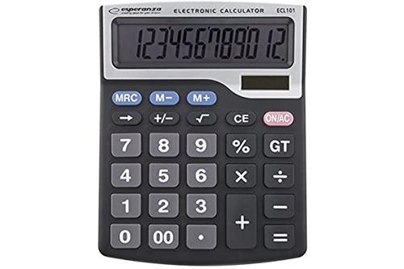
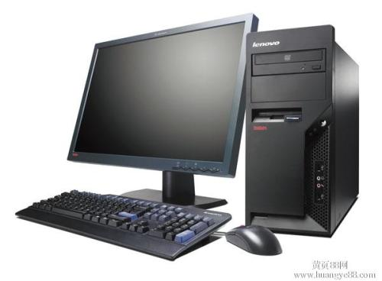
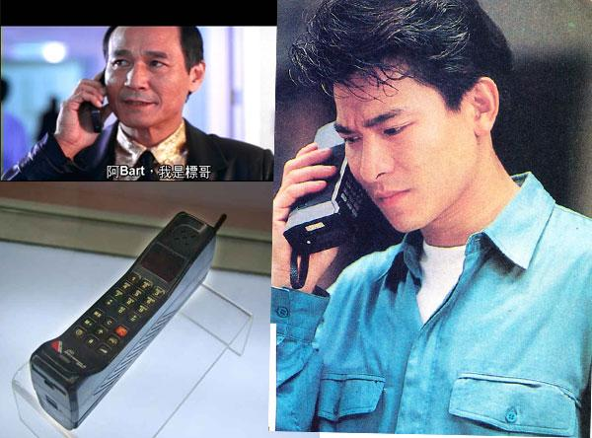
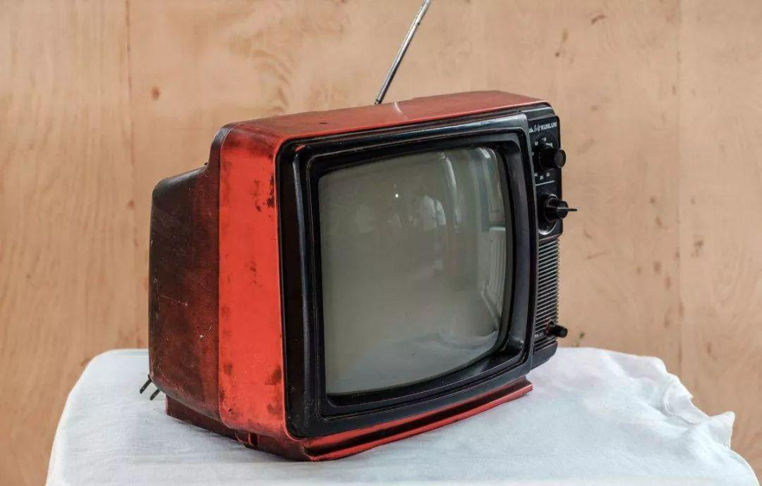
Is this a computer?

Slide 10
This is a computer (physically)
A machine
An auto machine
An auto machine which can do very very fast calculations.
Fast enough that calculations have evolved into omnipotence!

Slide 11

How fast?
Intel CPU i9-9900KS 8-core 4.0GHz
$4×{10}^{9}×8=3.2×{10}^{10}$/second elemental actions (calculation) !

Slide 12
What is calculation?
arithmetical calculations
logical calculations
Hyper-function calculations
So why is this not a computer?

Slide 13
This is a computer (physically)
A machine
An auto machine
An auto machine which can do very very fast calculations.
Fast enough that calculations have evolved into omnipotence!
Programmable
Memorable
Configurable

Slide 14
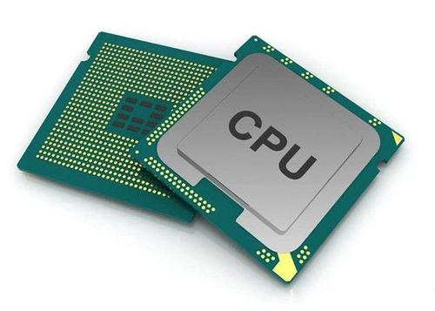
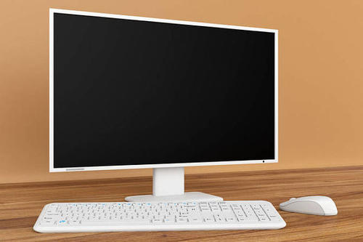
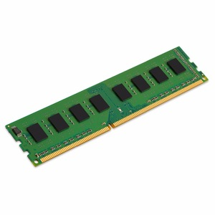
This is a computer (physically micro view)
A machine
An auto machine
An auto machine which can do very very fast calculations.
Fast enough that calculations have evolved to omnipotence!
Programmable
Memory
Configurable

Slide 15
This is a computer (physically micro view)
Von Neumann Architecture：CPU+Memory+I/O

Slide 16
On what targets calculations perform
Numerical values
Integer
Float
Binary system

Slide 17
It seems that computer can do more than calculations? Yes! Coz:
Assign data meanings -> information
00110001 → decimal integer 49
00110001 → char ‘1’
00110001 → color value
00110001 → pure bits
Doing calculation means processing information with helps of I/O devices and softwares rendering
Encoding data with information which is being sensed by I/O devices targeting on human

Slide 18
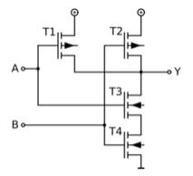
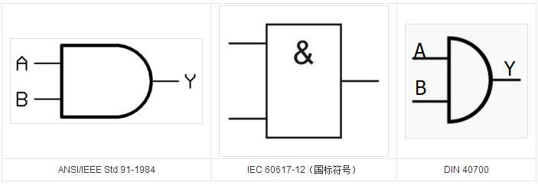
How computer exactly does calculation?
Boolean algebra: theoretical guarantee
Combinational ANDNOTs can do everything
Digital circuit: physical implementation
ANDNOT gate

Slide 19
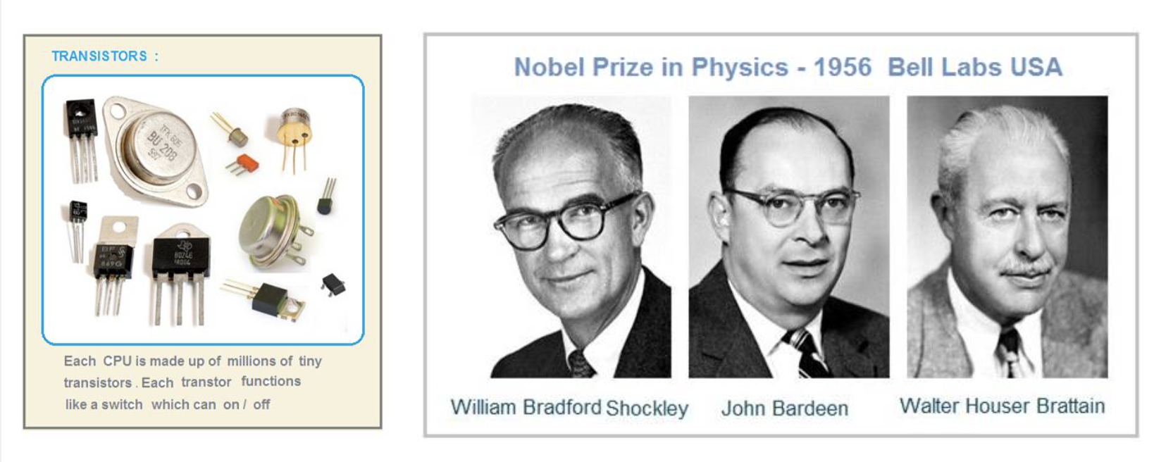
Transistor invention

Slide 20
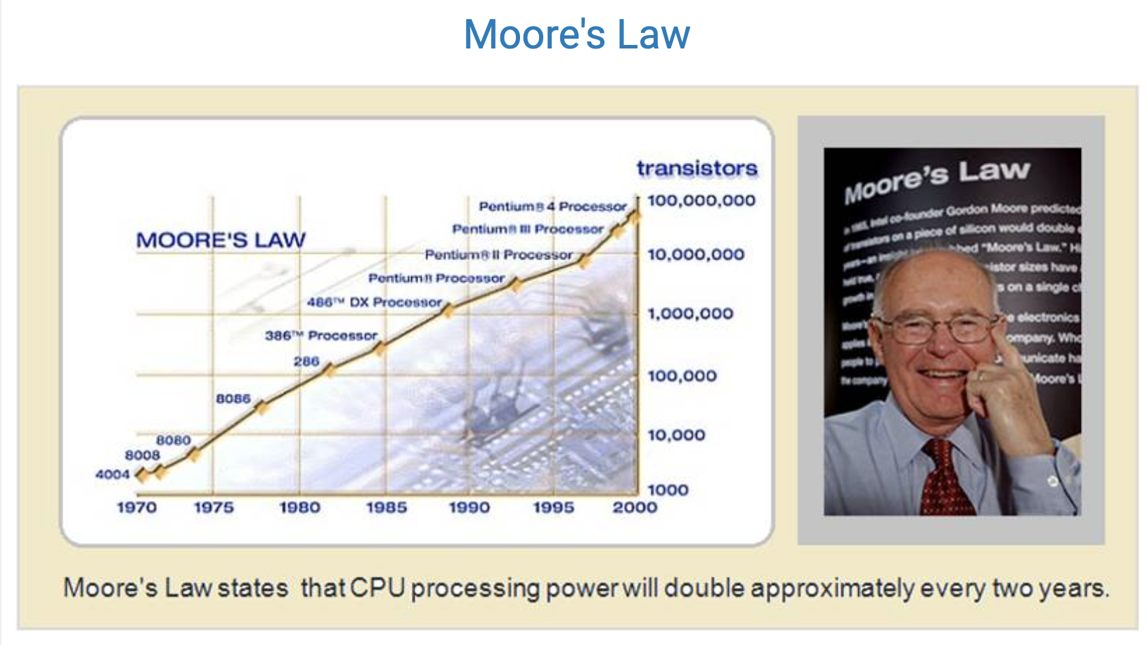

Slide 21
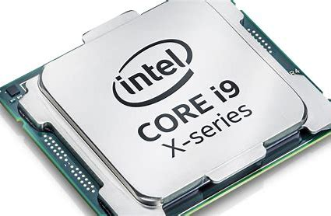

VLSI makes calculation appear as of processing
VLSI/ULSI/GIS: 1994 1GDRAM >${10}^{9}$
1.736B for Intel Core I9
2B for Apple A8

Slide 22
This is a computer (mentally macro view)
A machine
An auto machine
An auto machine which can process information in very very fast way:
Store
Transfer
Render
Search
……

Slide 23
Computers categories
Size-oriented
Server, PC, notebook, smart phone, monitors, ……
Purpose-oriented
General purpose computers
Specific purpose computers

Slide 24
What is CS?
CS: Computing Science
Science of using computer for solving target problems
“computing refers to a goal-oriented activity requiring, benefiting from, or associated with the creation and use of computers.”—CC2020
Developing Computational thinking tools for solving target problems
Notes:
As originally expressed in CC2005 [Acm02], computing includes a variety of interpretations such as designing and constructing hardware and software systems for a wide range of purposes: processing, structuring, and managing various kinds of information; problem solving by finding solutions to problems or by proving a solution does not exist; making computer systems behave intelligently; creating and using communications and entertainment media; and finding and gathering information relevant to any particular purpose.

Slide 25
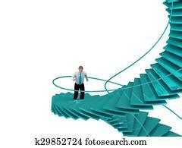
What is computational thinking: intuitive examples
Comparing to another hot word: internet thinking
Sample problem 1:
1D random walk
Coin head/tail: up/down 1 step
When walking long N steps
how far average from the original ?
0?

Slide 26

1D random walk: math solution
$\sim \sqrt{\frac{2N}{π}}(1∓\frac{1}{4N}+\frac{1}{32N^{2}}±\frac{5}{128N^{3}}−\frac{21}{2048N^{4}}∓…)$

Slide 27
1D random walk: computing solution
def serial(n):
pos = 0
for i in range(n):
head = random.random()
if head > .5 : pos += 1
else : pos -= 1
return abs(pos)
def serial_version(n, tries):
count = np.zeros(n+1)
for i in range(tries): count[serial(n)] += 1
return count
res = serial_version(n,tries)
s = 0
for I in range(n+1): s +=res[i]*I
Print(s/float(tries))

Slide 28


Sample problem 2: $\sqrt{2}=?$
Guess $x^{2}=2$
x1=1, x2=2, x3=(x1+x2)/2=1.5, x4=(x2+x3)/2 ……

Slide 29
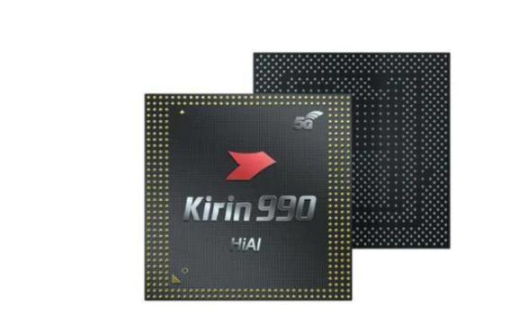
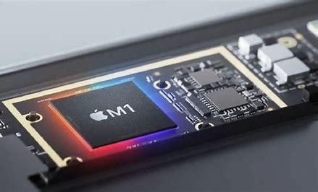
Are they different kind of computers?
Formalize computing: Turing machine
Despite all kinds of different calculations what “computer” provides
What TM can do is called computing
So-called computer should be TM-compatible

Slide 30
What is Turing machine
A big question which will be introduced latter.

Slide 31
Key ideas of this lecture
CS is the science about computer

Slide 32
Homework 1
Read news and papers about JiuZhang（九章） and ZhuChongZhi（祖冲之）. Are they (quantum) computers? Using your own language:
List positive reasons
List negative reasons
What is your decision? Justify your conclusion.

